Slide 1
Aerospace
Engineering
Department
Amirkabir University of Technology

Slide 2
Academic Groups include
Aerospace
Engineering
Department
Amirkabir University of Technology
M. Sc.
Aerodynamics
Propulsion
Satellite Technology
Flight Dynamics & Control
Space Engineering
Aerospace structures
Ph. D.
Aerodynamics
Propulsion
Satellite Technology
Flight Dynamics & Control
Space Engineering
Aerospace structures
B. Sc.

Slide 3
Aerospace Engineering Department An Overview…..
Full-time faculty members:
Professors: 9
Associate Professors: 6
Assistant Professors: 7
Total: 22

Slide 4
History
The Aerospace Engineering Department at Amirkabir University of Technology was founded in 1987 as the first specialty school on Aerospace Engineering in Iran and the region of middle-East. In the same year the department started to admit students for the degree of Bachelor of Science (BSc) in Aerospace Engineering.

Slide 5
History
In 1993, the department introduced its first master of science (MSc) program in Aerodynamics following with 3 other majors in Flight Dynamics, Propulsion and Aero-structures in 1995. This was a significant point in the history of the department for serving both scientific and industrial communities and providing high-level educational services. In 1997 and for the first time in Iran, a number of students were admitted for the doctor of Philosophy (PhD) program. So far, the department has been able to have considerable contribution to the national and international scientific communities and significantly extend the specialty human resources majoring in Aerospace Engineering.

Slide 6
Vision
The Aerospace Engineering Department intends to become one of the top Aerospace engineering departments in the reign of middle-East and advance in the following items:
International contribution in conducting cutting-edge research
Contribution in industrial projects
Quality education
providing the required specialty human resource for industries

Slide 7
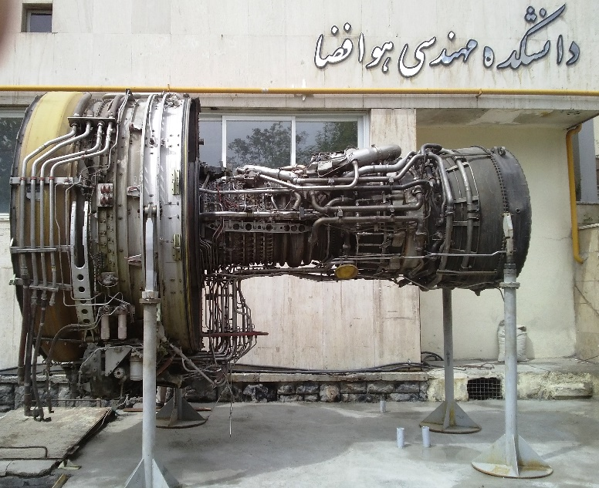
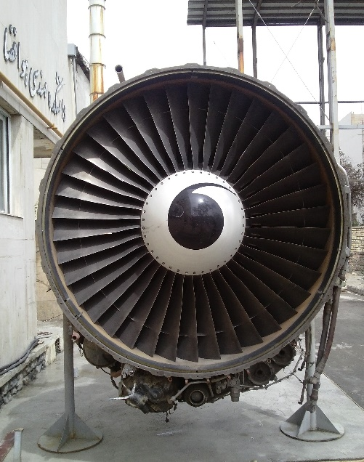
Mission
Conducting Cutting-edge research for meaningful international contribution
Educating the required human resources for the national industrial needs
Responding to the industrial demand of the country

Slide 8
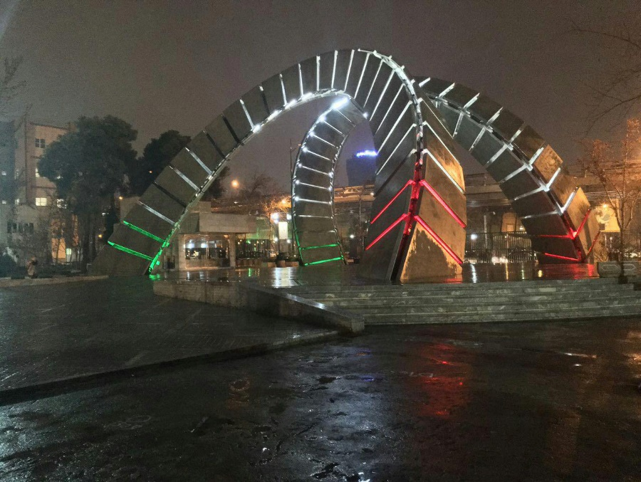
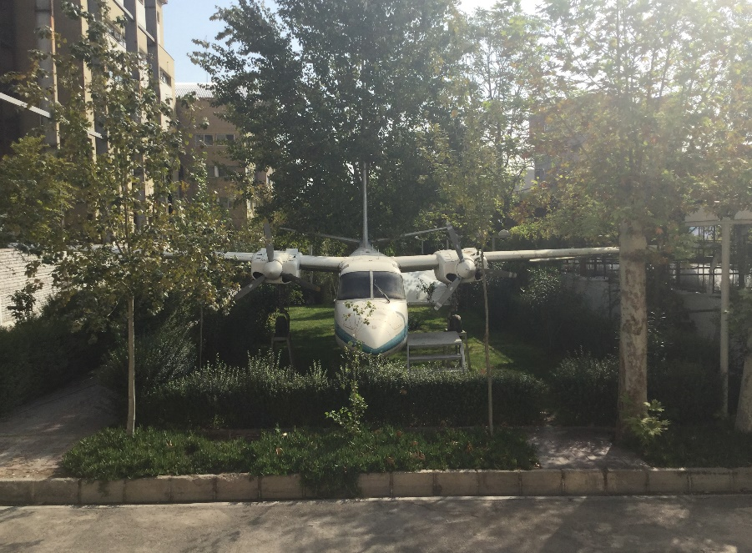
Educational capabilities
The department admits undergrad- and grad-level students offering Bachelor of Science, Master of science and doctor of philosophy degrees. A considerable portion of the required human resources for the national Aerospace industries have been from the graduates of this department.

Slide 9
Bachelor of Science
The bachelor program is offered to educate capable engineers who can effectively work in related industries. As such, a number of the best-ranked students in the nationwide entrance exam are admitted to the department annually. After four years, bachelor-graduates are able to play their role as engineers in Aerospace and related industries such as automobile, renewable energies and petroleum industries.
Topics such as Aerodynamics and design of flying vehicles, propulsion systems, Aerospace structures, control and navigation systems and space/satellite systems are taught to students.

Slide 10
Master of Science
Bachelor-graduate students can continue their education at the graduate–level and pursue a master degree in six different majors, namely aerodynamics, flight dynamic and control, propulsion, aero structure, space engineering and satellite technology.
At this level, the department offers advanced courses to deepen the students ‘scientific insights’ combined with applied research topics.
After completion of the period, highly capable engineers with valuable expertise are introduced to the national scientific and industrial communities. Unique experimental and computational facilities such as the low-speed wind tunnel designed and built at the department, composite materials lab, jet engine test-cell and high-performance super computers have substantial impacts to effectively improve the graduate-level education and research at the department.

Slide 11
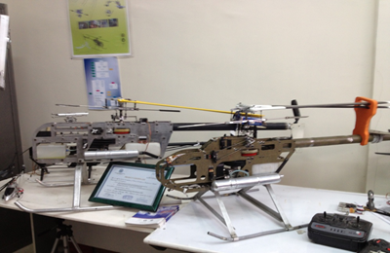
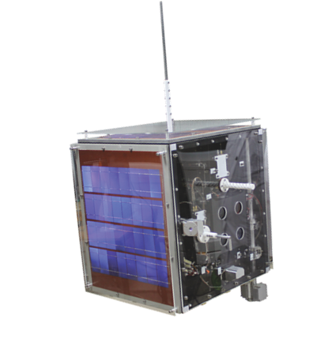
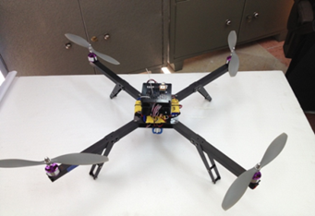
Doctor of philosophy
PhD students are selected among the best nation–wide master graduates who are willing to conduct cutting–edge research to respond the critical industrial and scientific demands and provide the future generation of professors of the country. So for, many notable industrial achievements have been the outcome from the deportment’s PhD projects.

Slide 12
Aerospace Engineering Department An Overview….
Full-time students currently studying in the department:
B.Sc Students: 260+
M.Sc Students: 130+
Ph.D Students: 70+
Graduate students |  | Under graduate students
%44 | MSc and PhD | %56 | BSc

Slide 13
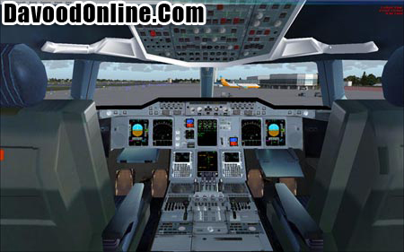
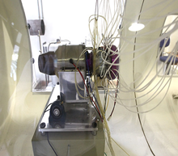
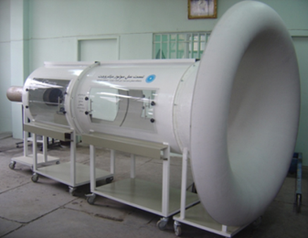
Research in the Aerospace Engineering Department
The department takes advantage of several modern laboratories and research centers introduced in the following.

Slide 14
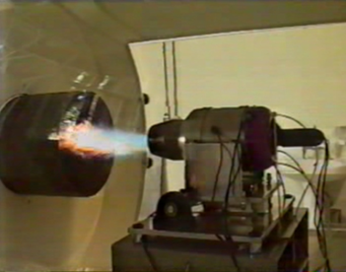
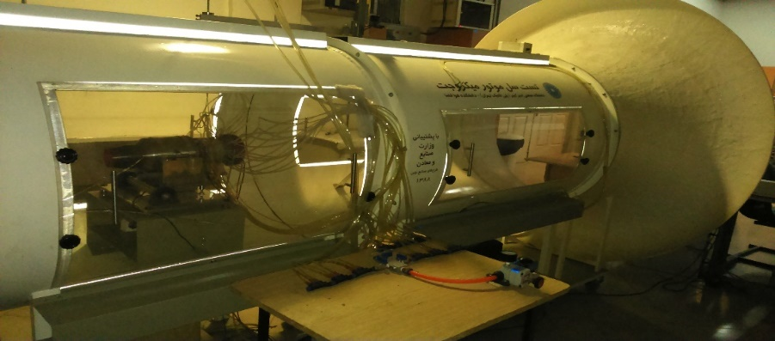
Aerodynamics and propulsion LAB
This lab conducts a broad range of experiments on the aircraft aerodynamics, propulsion (propellers and jet) systems and optimization of energy systems. Equipment such as subsonic and supersonic wind tunnels, shock tube, gas turbine and turbo machinery testers and different types of measurement equipment play a Key role in the above-mentioned LABs.
micro/mini jet engine test cell
micro-turbine test cell
gas turbine engine simulation system

Slide 15
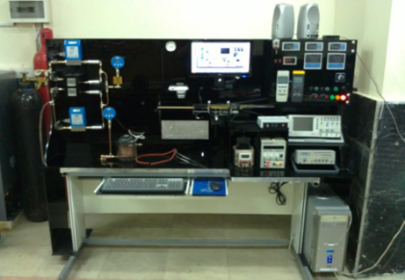
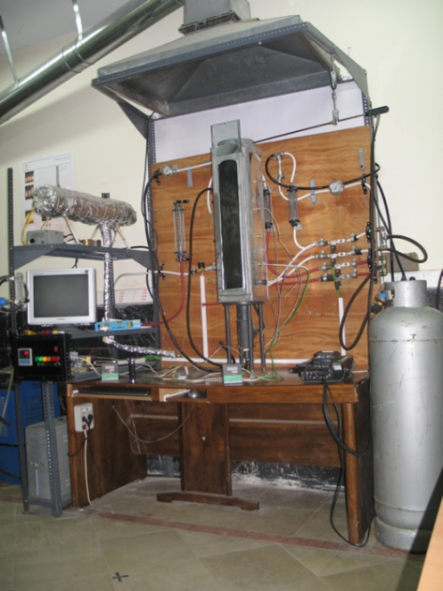
Combustion and turbulence LAB
This lab concentrates on performing experiments on turbulent. mixing, two-phase flows and combustion in different scales. High-tech equipment such as industrial and research-level burners, micro-combustion test stands, rotational burners and combustion chamber of turbine-driven engines are among the labs equipment. High-performance super computers have considerable impacts to improve the simulation-based researches in the department.
combustion test-bed
research combustion chamber in swirling flames

Slide 16
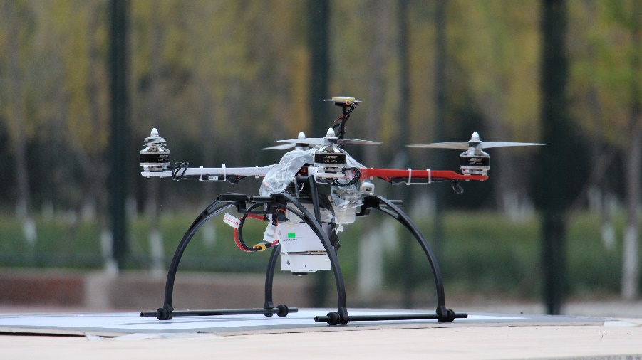
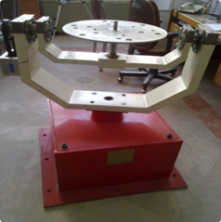
Flight dynamics and control LAB
The focal point of this lab is the analysis of dynamics of aerial and space systems, flight tests, hardware and software in the loop and design of control systems, flight simulators and reality system.
three dimensional gyro -simulator
flight simulator

Slide 17
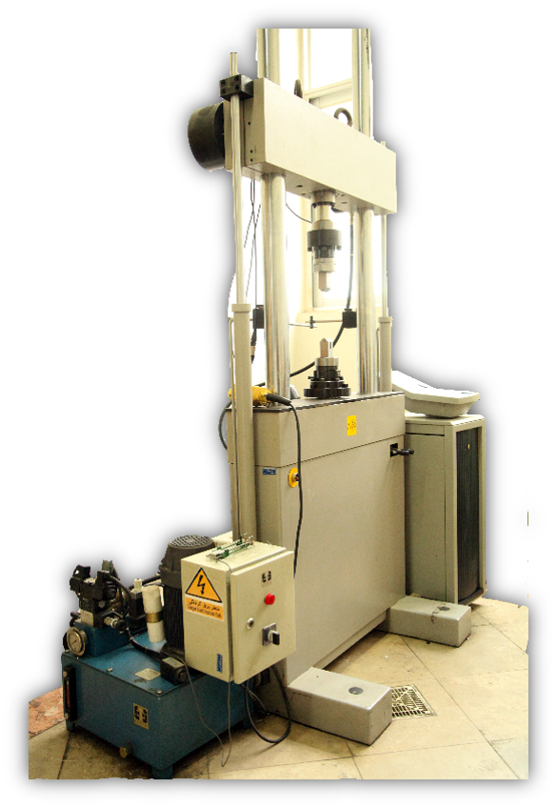
Aero-structures and composite materials LAB
This laboratory takes advantage of a broad range of equipment such as shaker systems and accelerometer, modal test-stand, autoclave and fracture test system which are bought or domestically built through several grade-level projects. Research in this lab is conducted on mechanical properties of material, life assessment and fatigue, buckling, modal analysis, balancing of rotational systems, vibration control and dynamic systems.

Slide 18
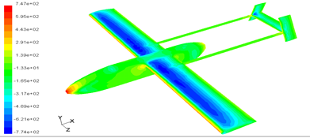
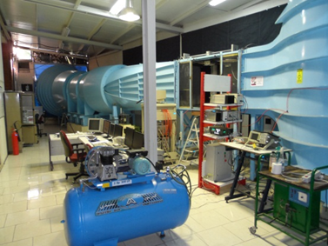
Research capabilities
Aerodynamics
Conducting cutting-edge experiments on the aerodynamics of flying vehicles in different flight regimes
Estimation and optimization of aerodynamic coefficients and providing the knowledge-based data required for industries
Flow simulation using in-house codes and commercial packages on super-computing platforms
Aerodynamic design of flying vehicles
Design and building subsonic wind-tunnels

Slide 19
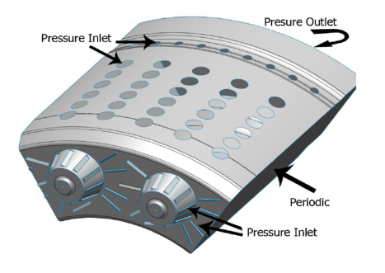
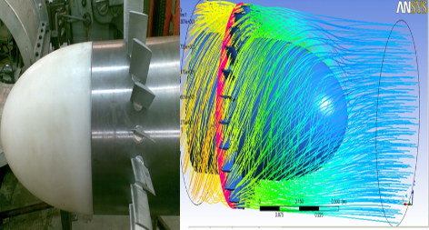
Combustion and propulsion
Design and prototyping advanced HICOT burner
Design and prototyping micro combustion chambers
Flow simulation in different combustion chambers
Design and building the compressor test stands
Design and prototyping test-beds for micro jet engines
J85 engine combustion chamber analysis
tDesign of experimental compressor
est-stand

Slide 20
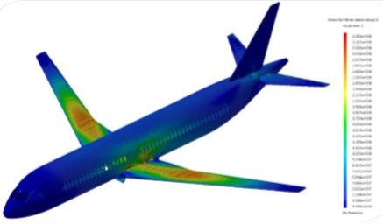
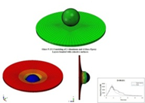
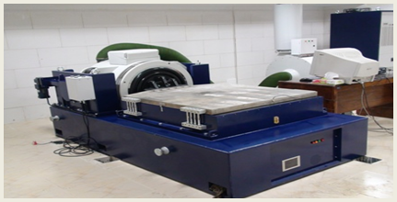
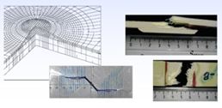
Aero structures and advanced materials
Model tests for dynamic systems
Design and building balancing mechanisms for frequencies above 2000 Hz
Life assessments and buckling
Life extension and fatigue
Loading specification for Aerospace structures
airplane structural load analysis
damage analysis caused by collision
shaker system
failure and crack growth analysis

Slide 21
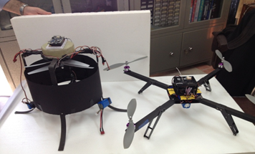
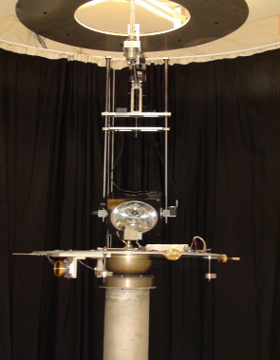
Flight dynamics and control
Dynamics Analysis and modeling for different flying vehicles (aircraft, helicopter and multi-rotor systems)
Design and building unmanned aerial vehicles
Conceptual and preliminary design of different flying vehicles
Design and building different flight simulators
Designing satellite launch systems
Designing group-guidance algorithms
Design and testing different hardware-in-the-loop and software-in the loop systems
Designing navigation systems (inertial, vision, satellite, etc.)
Designing avionic systems
rotor-craft design
condition determine and control lab
remote pilot helicopters

Slide 22
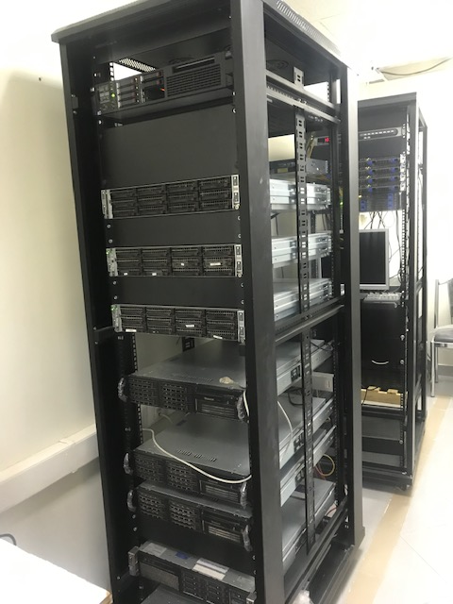
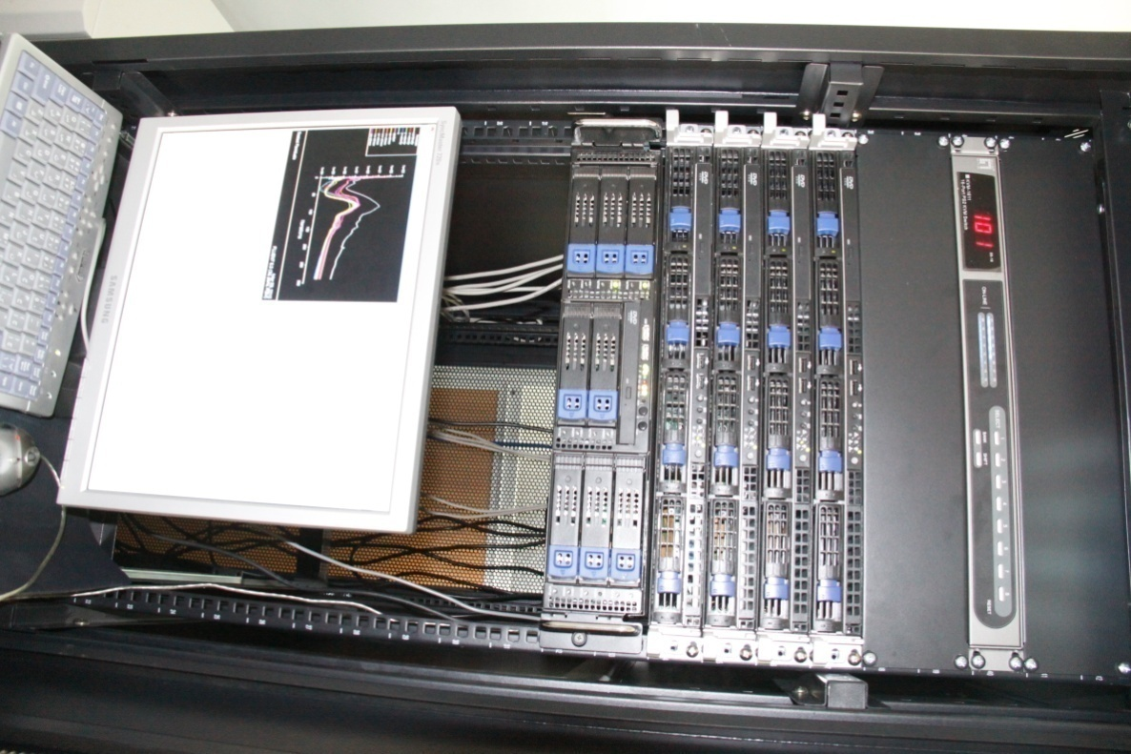
Parallel processing & Supercomputing

Slide 23
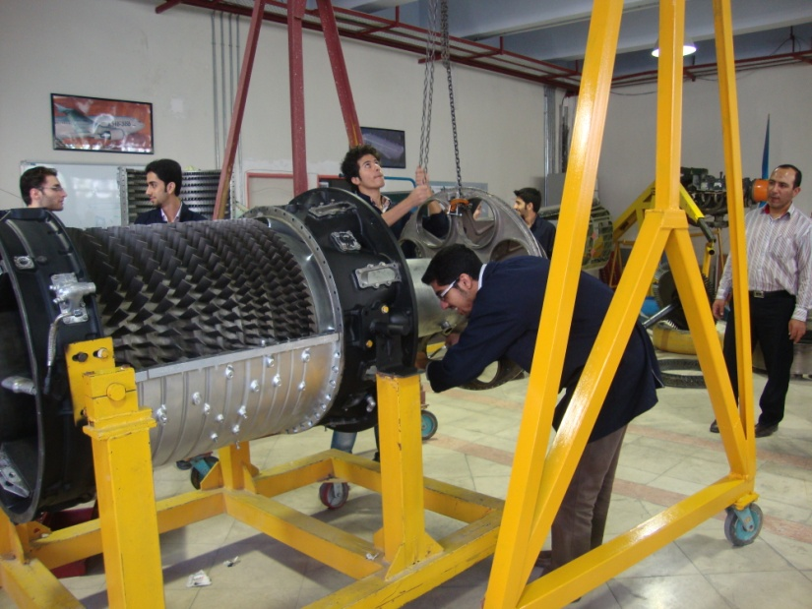
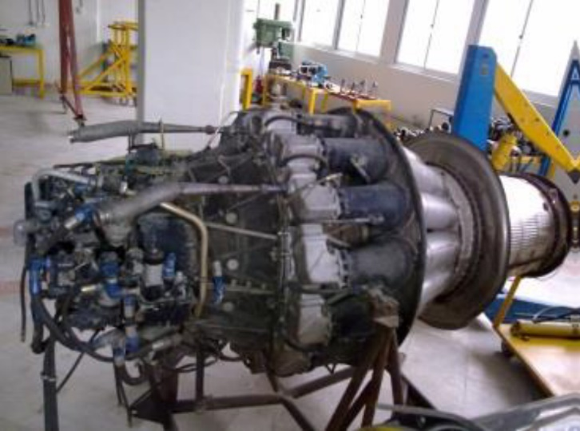
Workshops and Labs
Wing, Fuselage and Engine Workshops

Slide 24
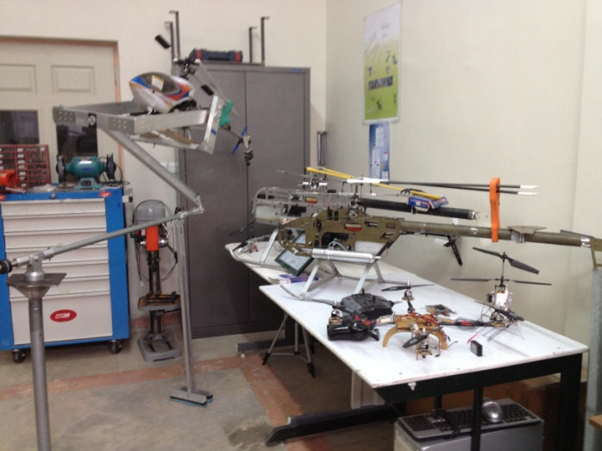
Workshops and Labs
instrument and Avionic Workshop

Slide 25
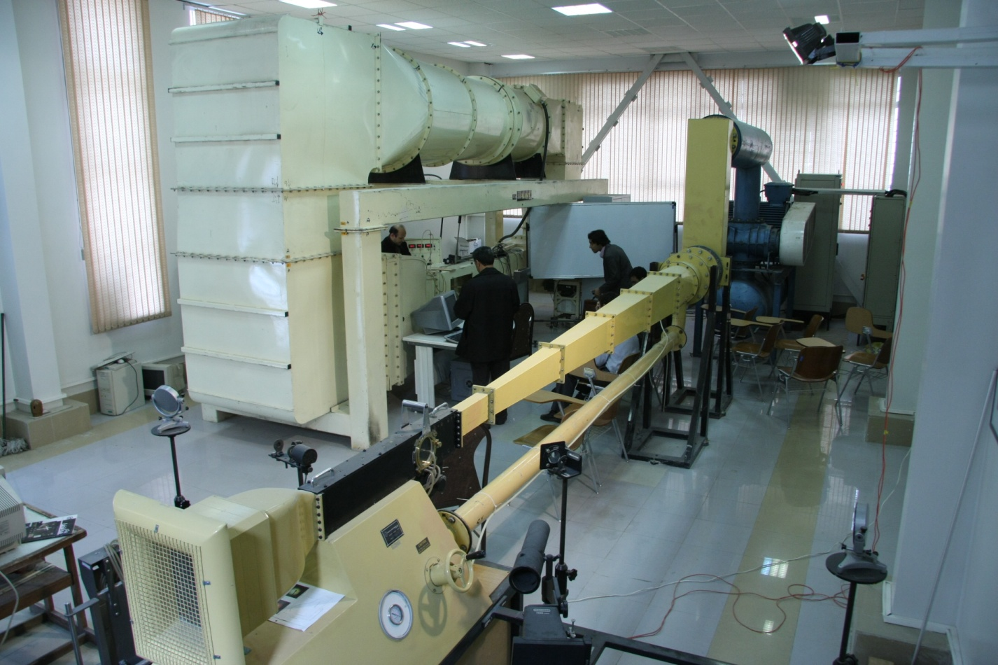
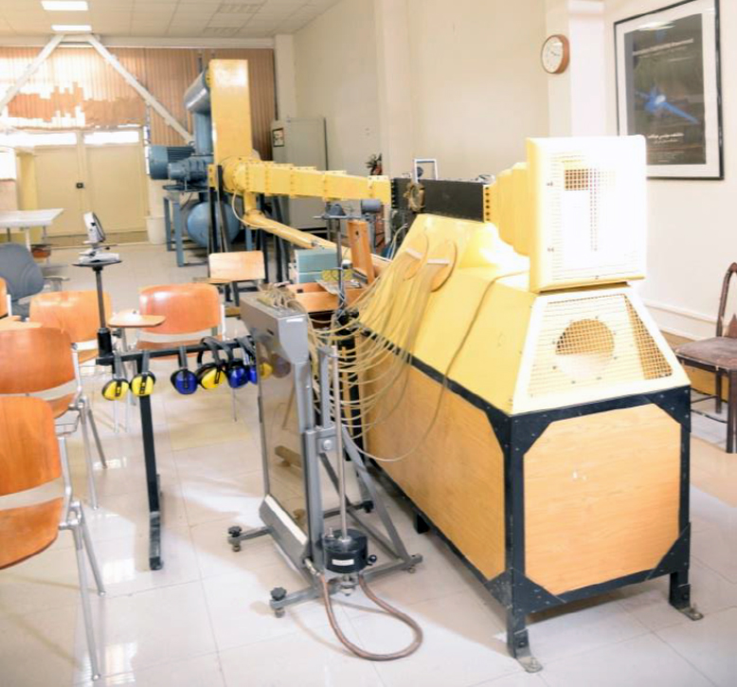
Workshops and Labs
Subsonic and Supersonic Wind Tunnels

Slide 26
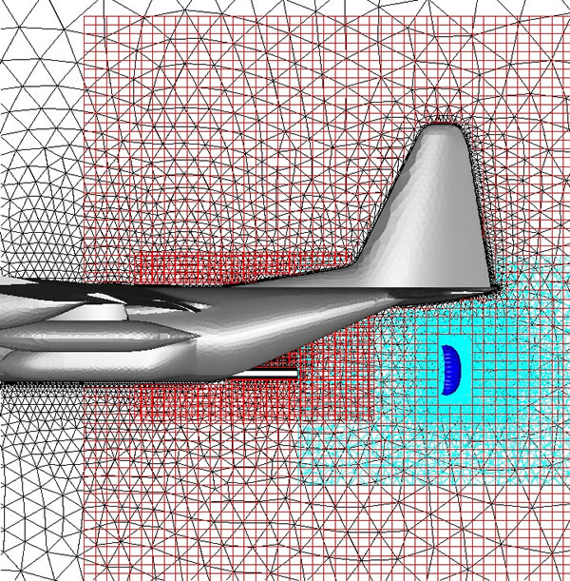
Center of Excellence in Computational Aerospace
In 2007, the department was the first department in Iran which was recognized by the Ministry of Science, Research and Technology as the “Center of Excellence in Computational Aerospace Engineering”.

Slide 27
Contributions in National Projects

Slide 28
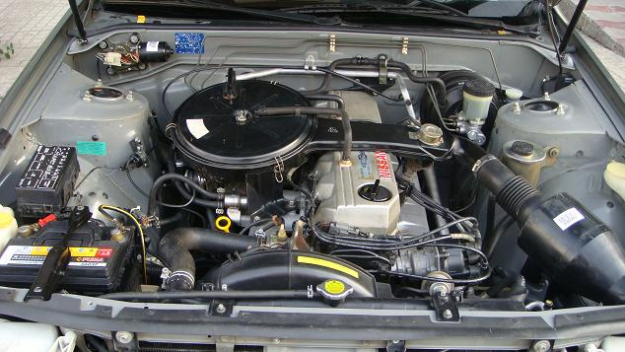
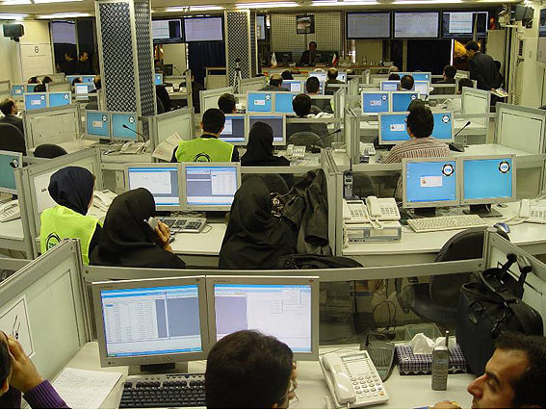
Reduction of vehicles’ greenhouse gas emission

Slide 29
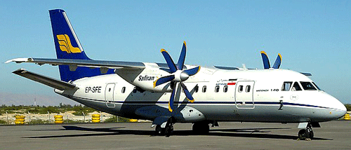
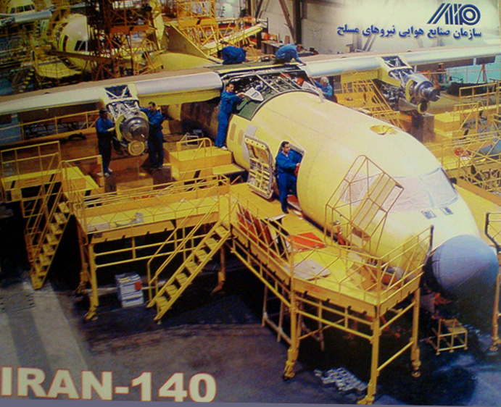
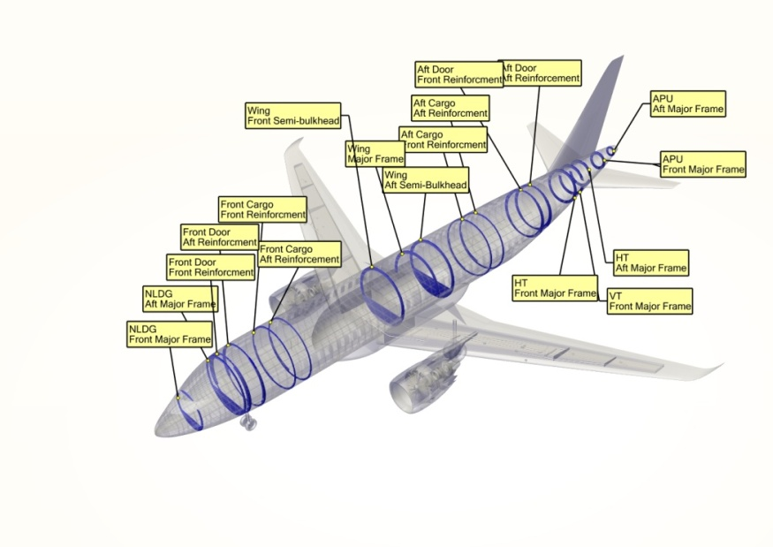
Commercial aircraft technology development

Slide 30
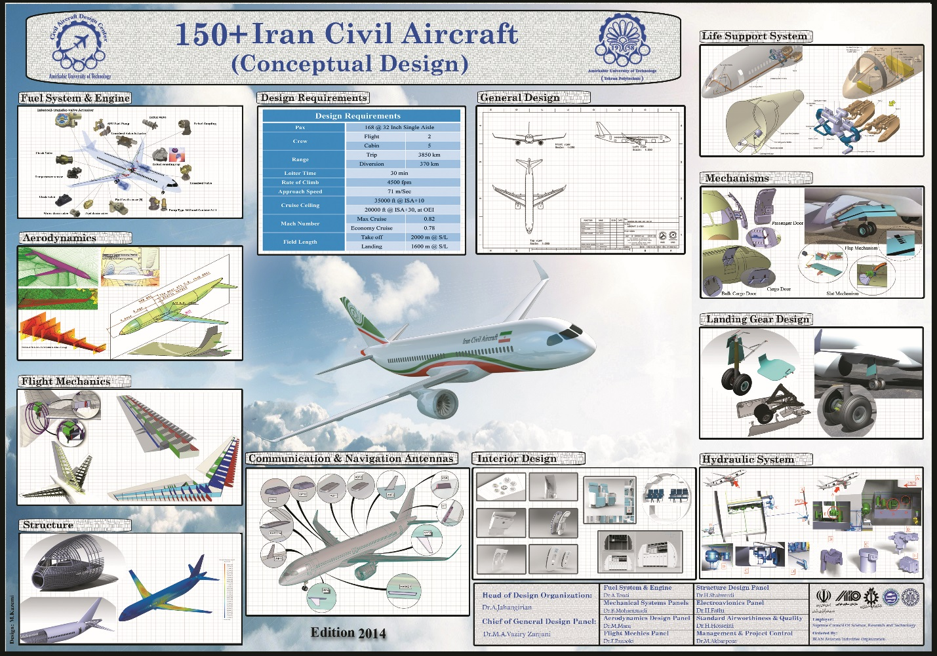
Commercial aircraft technology development

Slide 31
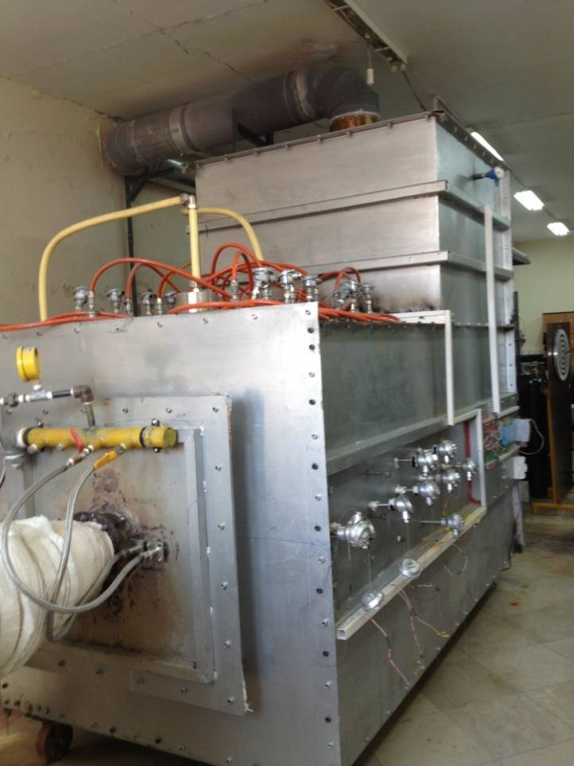
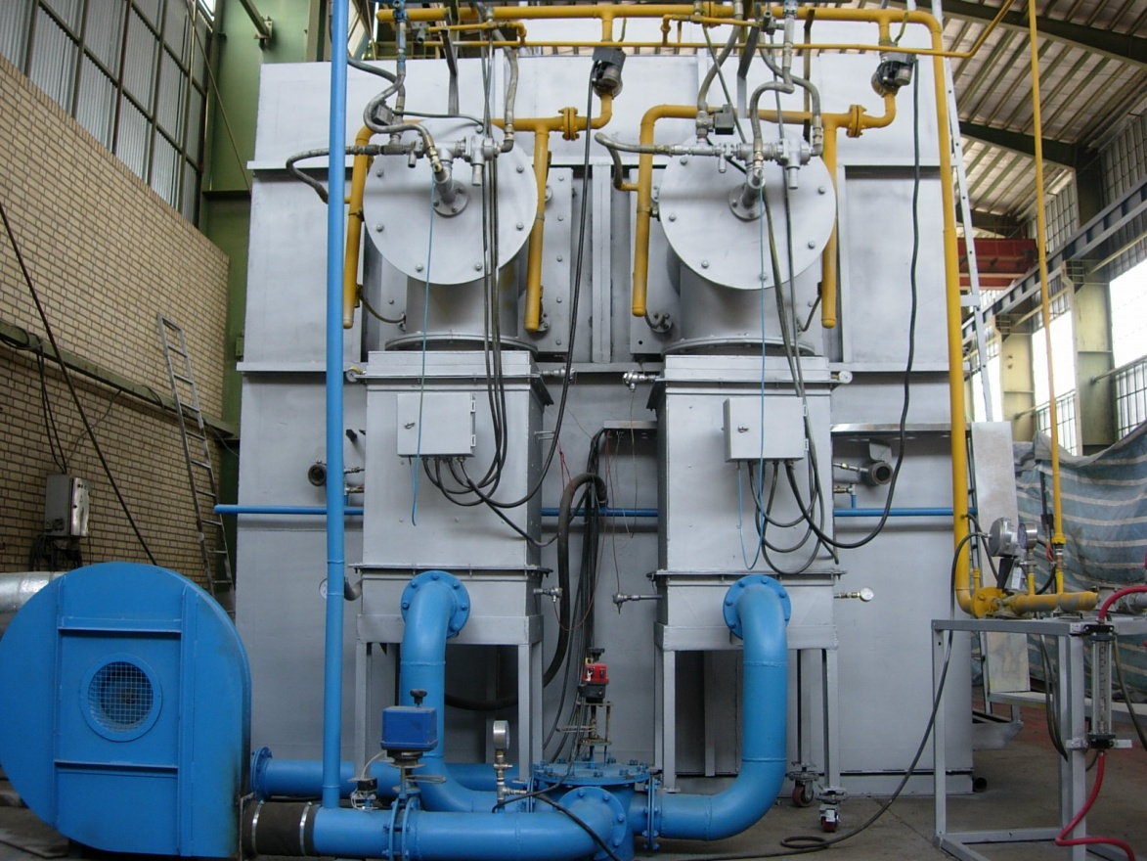
Energy Industries

Slide 32
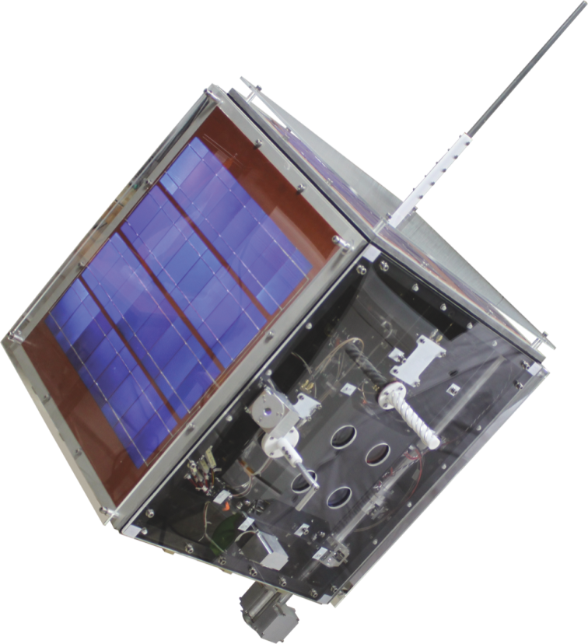
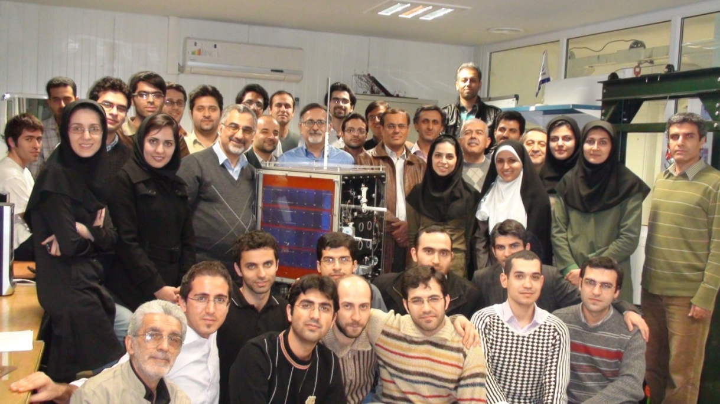
Amirkabir University of Technology Satellite (AUTSAT)

Slide 33
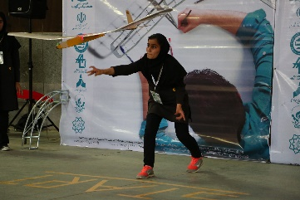
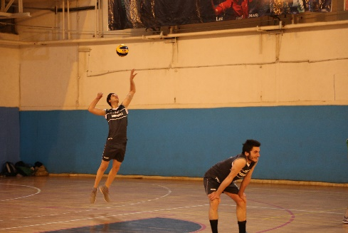
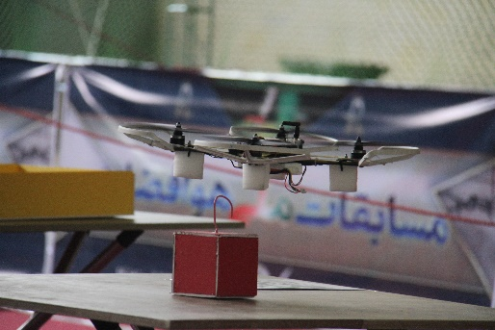
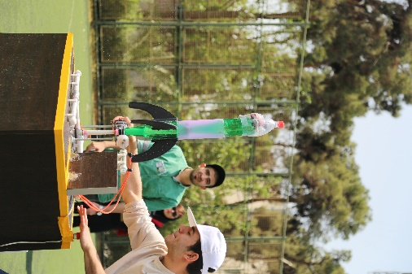
Students social and group activities
Students in this department passionately participate in different social-cultural activities.
Students competitions
Students publications
Scientific and technical group visiting
Charity activities
Sport & Recreation

Slide 34
